Slide 1

Cross Validation

Slide 2
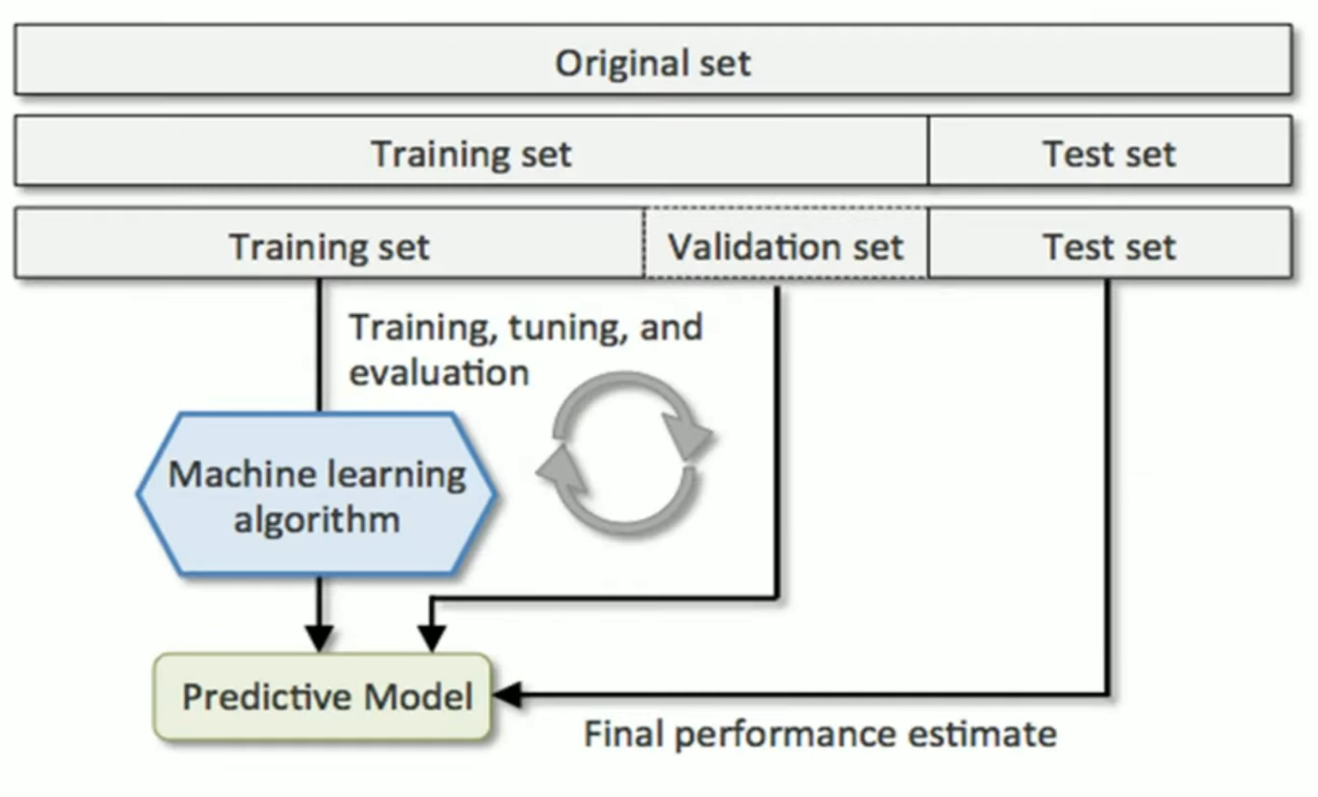
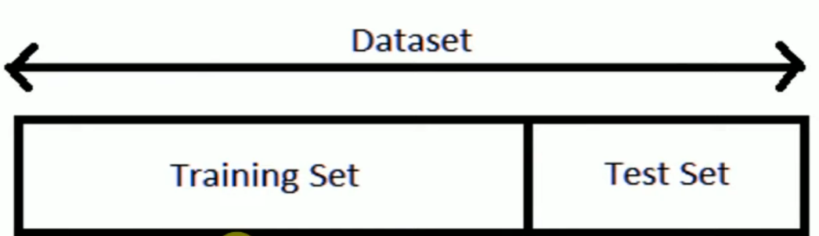
Train Test Validate Data in Machine learning

Slide 3
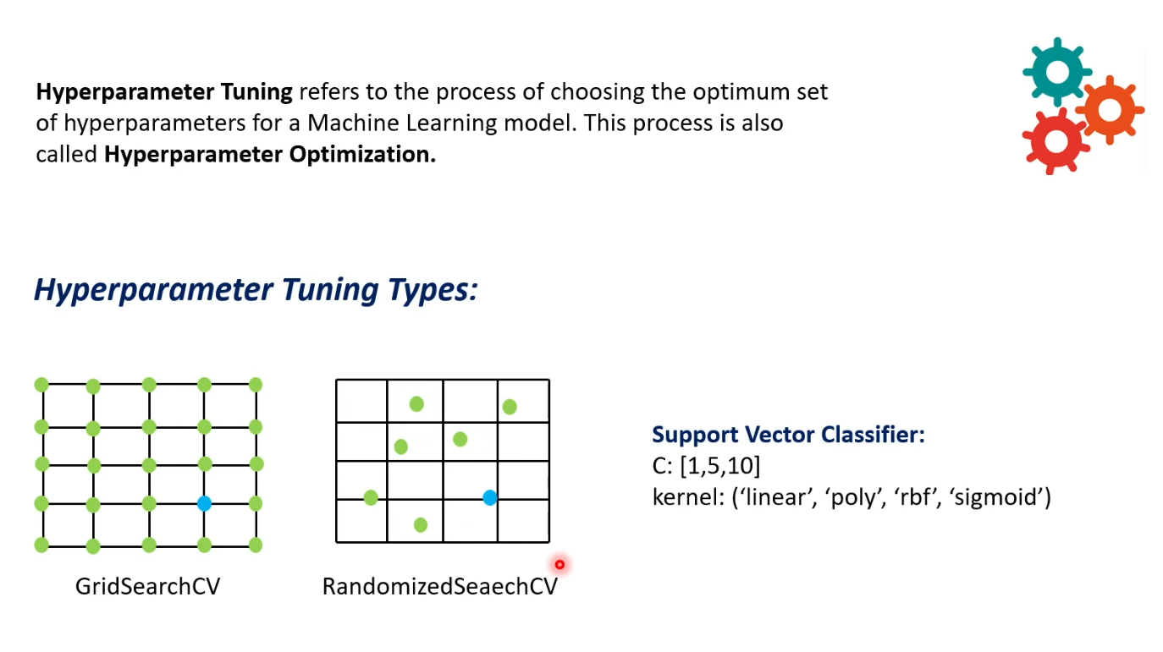
Hyperparameter Tunning

Slide 4
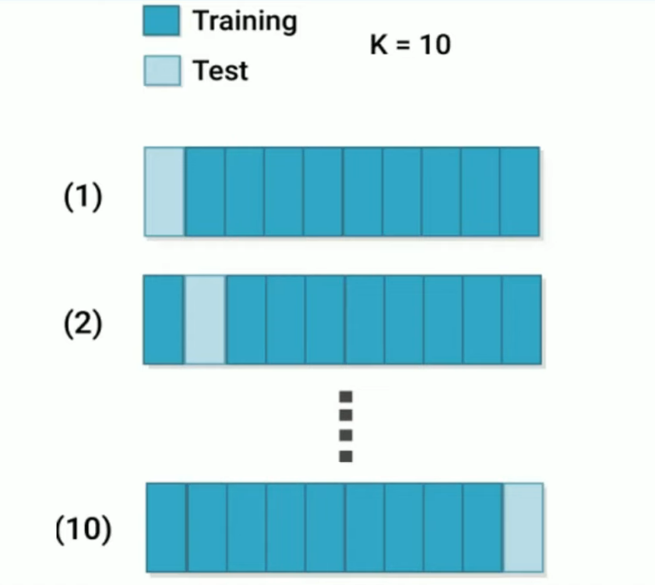
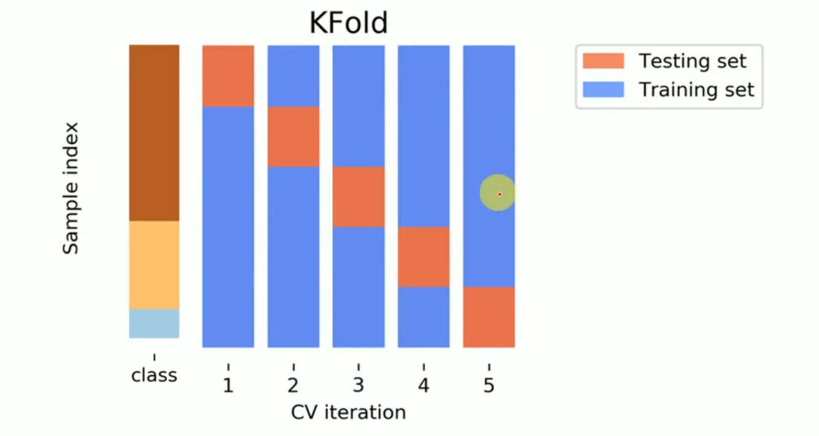
K Fold Cross Validation

Slide 5
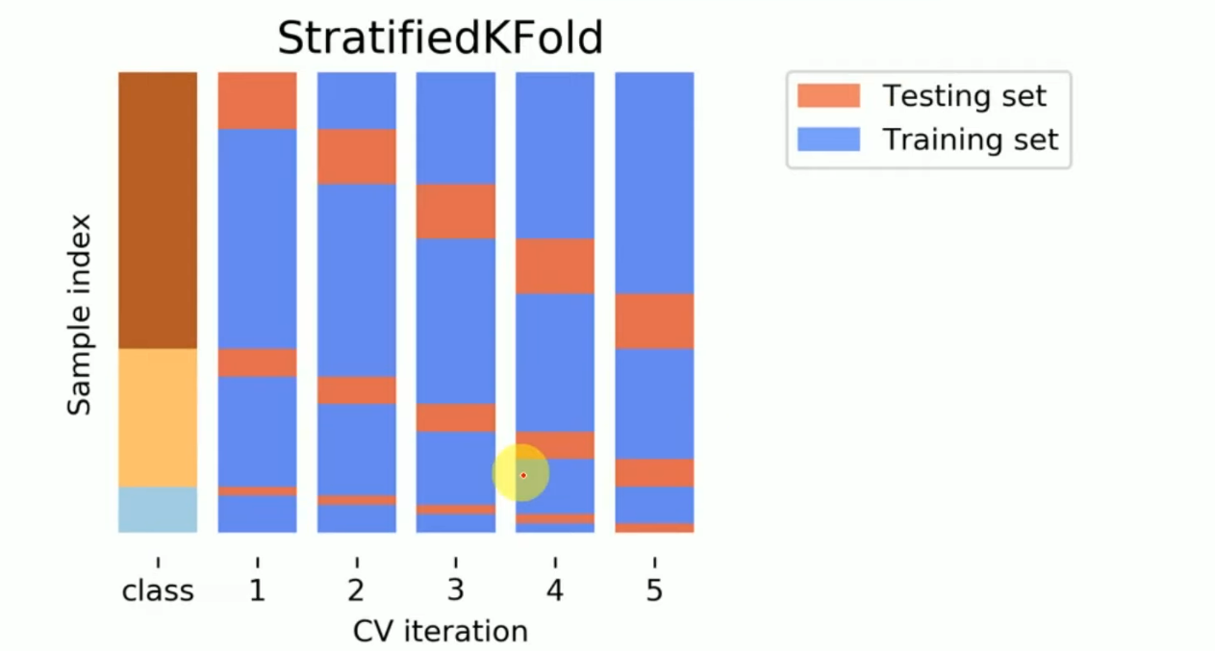
Stratified K Fold Cross Validation

Slide 6
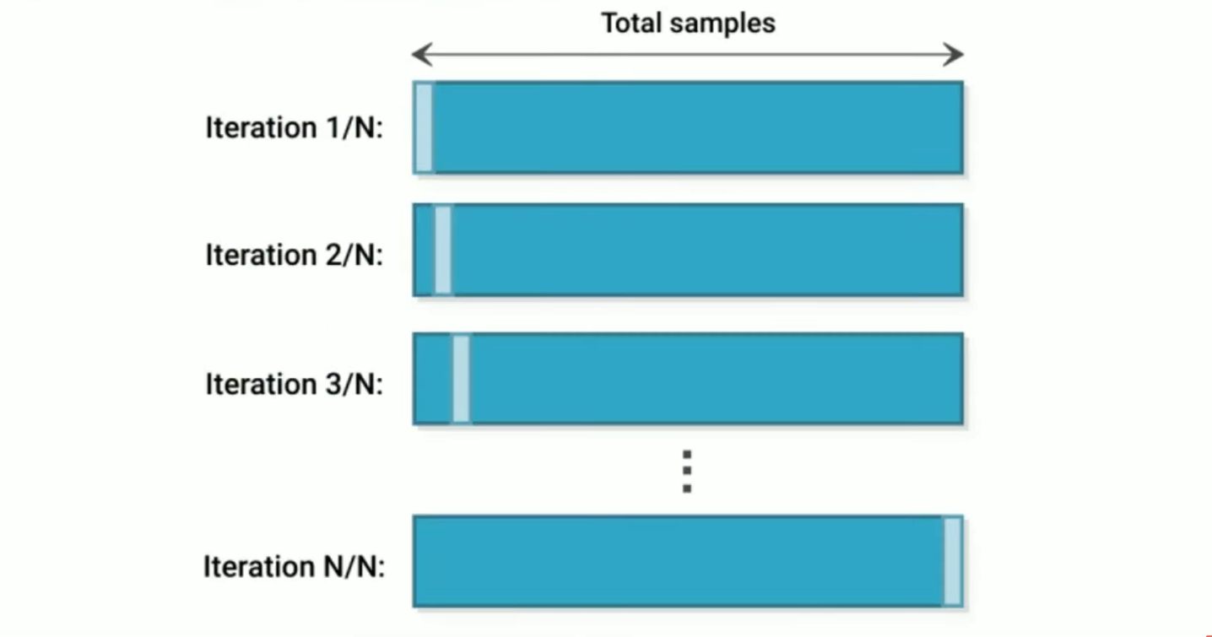
Leave-one-out Cross Validation

Slide 7
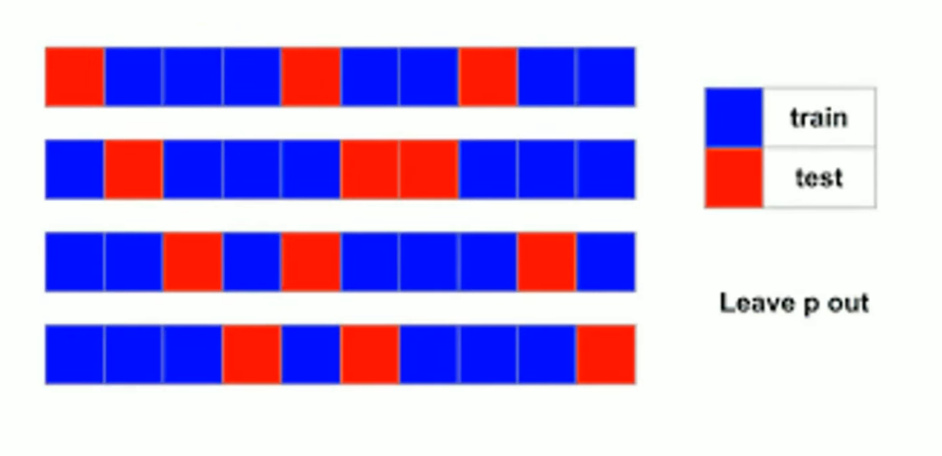
Leave-p-out Cross Validation

Slide 8
Thank You

